Slide 1
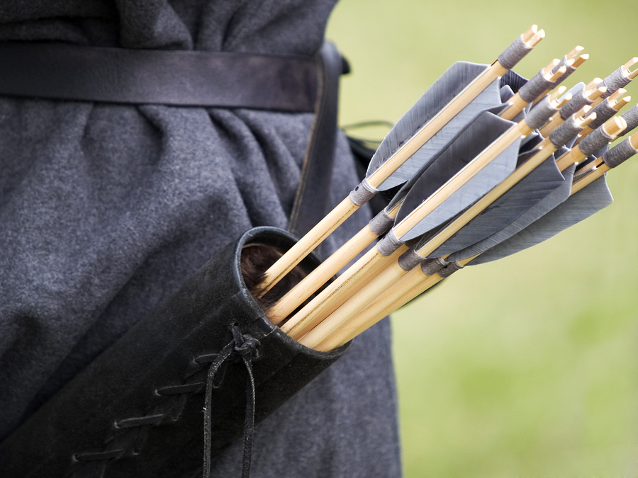
“Like arrows in the hand of a warrior”
P
S
A
L
M
127
Notes:
Read entire Psalm (Beautiful language – Song about the home). Many good lessons to be learned from it…)
Verse 1, our homes must be established by God! (Founded upon divine principles)
Verse 3, children are a wonderful blessing from the Lord
Verses 4 & 5, the basis of our lesson today (Wonderful word picture here)
Imagine the bowhunter who trains so as to make sure he hits his mark when it counts. This person not only works at his aim, but also takes care of his bow and arrows so they are ready for the hunt.
We see this man is “mighty” because he shot his arrows purposefully toward his intended mark. He had an intended target in mind, and shot his arrows toward that target.
What does this statement from Psalm 127:4 teach us about parenting?
(Lesson principles based on a short article by Jarrod Jacobs)

Slide 2
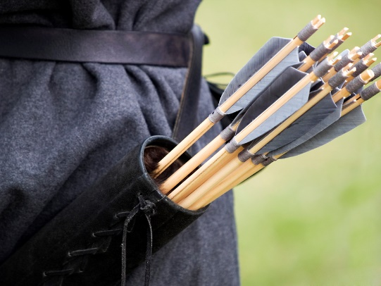
Children as Arrows
There is purpose in parenting
Ephesians 6:4; Genesis 18:19
Notes:
Parenting is more than just proving your ability to reproduce.
Parenting means taking responsibility for another life, and trying to make sure this life is productive in following God’s will and productive in society
(Ephesians 6:4), “And you, fathers, do not provoke your children to wrath, but bring them up in the training and admonition of the Lord.”
When we realize what God expects of us in parenting, it proves why parenting belongs to a married couple.
(Hebrews 13:4), “Marriage is honorable among all, and the bed undefiled; but fornicators and adulterers God will judge.”
From Abraham’s day, we see God’s purpose for parents. God said of Abraham,
(Genesis 18:19), “For I have known him, in order that he may command his children and his household after him, that they keep the way of the Lord, to do righteousness and justice…”

Slide 3
Children as Arrows
There is purpose in parenting
Ephesians 6:4; Genesis 18:19
Children can’t be left to raise themselves
Proverbs 29:15; 22:15; 22:6
Notes:
Psalm 127:4 shows us that just as arrows don’t fire themselves from the bow, so also children cannot be left to raise themselves.
Solomon understood this.
(Proverbs 29:15), “The rod and rebuke give wisdom, but a child left to himself brings shame to his mother.”
Children, left to themselves make foolish decisions
(Proverbs 22:15), “Foolishness is bound up in the heart of a child; the rod of correction will drive it far from him.”
They need training and encouragement from parents so that they can grow up, be parents themselves, and continue this process for another generation
(Proverbs 22:6), “Train up a child in the way he should go, and when he is old he will not depart from it.”
Parents, whether they have one or a dozen children, cannot put matters on “auto-pilot” and expect a good result when it comes to child-rearing!

Slide 4
Children as Arrows
There is purpose in parenting
Ephesians 6:4; Genesis 18:19
Children can’t be left to raise themselves
Proverbs 29:15; 22:15; 22:6
Parents must send their children out into the world
Matthew 5:16; Philippians 2:14-16
Notes:
We see that the “mighty man” purposely sent his arrows in the direction intended.
Sometimes, we find parents who never intend for their “arrows” to leave the “quiver”!
Thus, children grow up and seem to have no direction, or purpose in their lives. This is not right.
Parenting requires we send our “arrows” out into the world so that they can benefit this world as “shining lights”
Leaving father and mother, establishing their own home, living for Christ.
(Matthew 5:16), “Let your light so shine before men, that they may see your good works and glorify your Father in heaven.”
(Philippians 2:14-16), “Do all things without complaining and disputing, ¹⁵ that you may become blameless and harmless, children of God without fault in the midst of a crooked and perverse generation, among whom you shine as lights in the world, ¹⁶ holding fast the word of life, so that I may rejoice in the day of Christ that I have not run in vain or labored in vain.”

Slide 5
Conclusion
As parents, we must fulfill our responsibility to our children, to raise them in the “right way”, the way of the Lord!
Notes:
If we have been lacking in this area, let us repent and start today to follow the Lord’s will.
Following what the Lord says will benefit us, our children, the church, and the community in which we live.
Don’t be selfish, but selfless.
Give our children the “tools” necessary for living in this world and preparing for the next

